Slide 1


Eligible Job Profile
in Phase 1

Slide 2




Slide 3


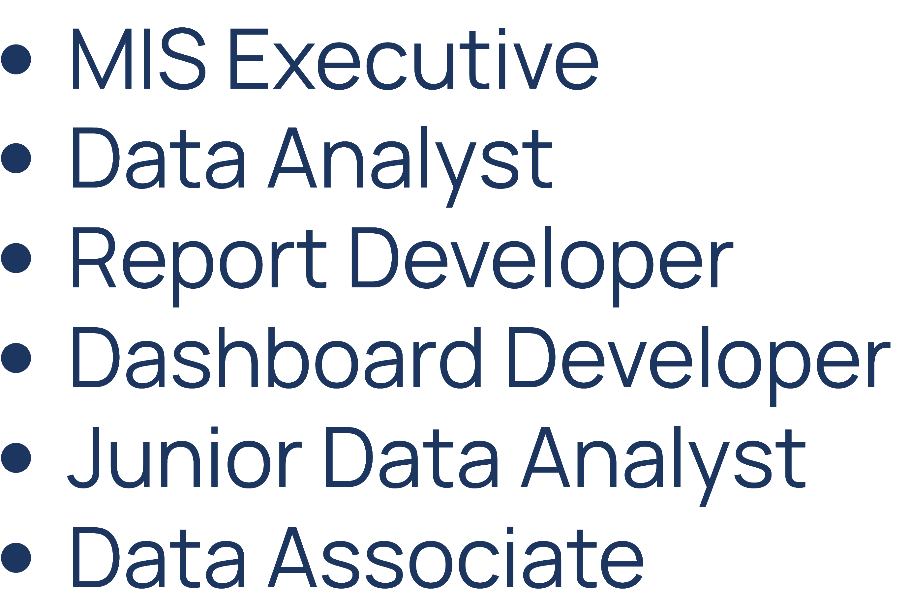

Slide 4


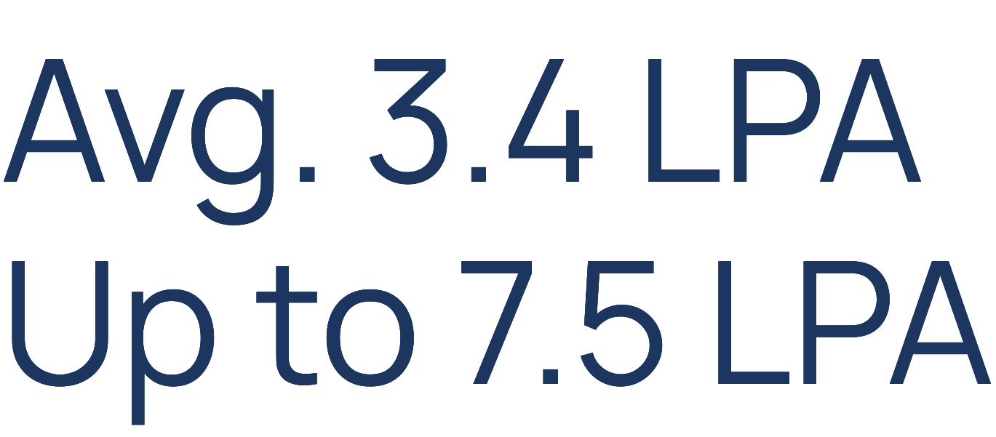
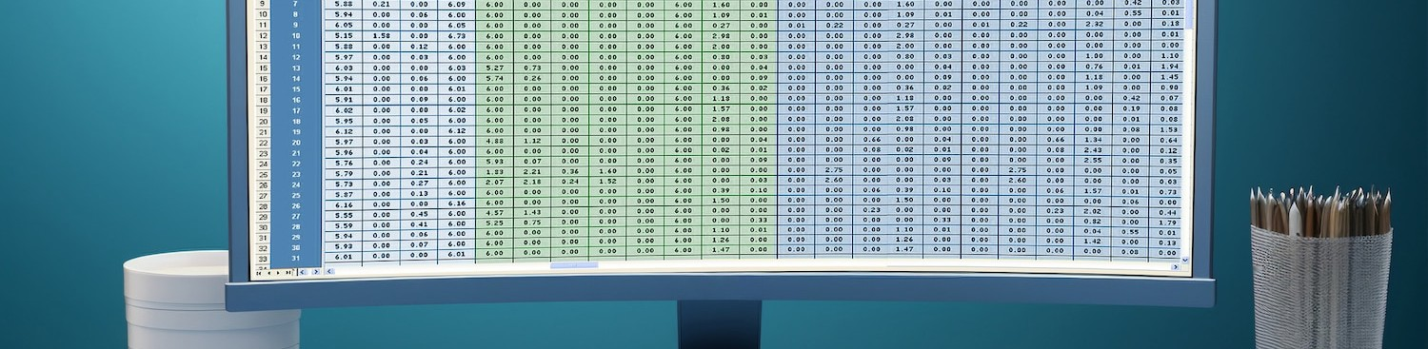

Slide 5
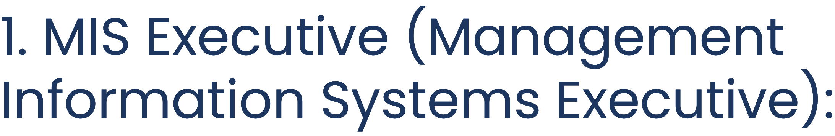

An MIS Executive is responsible for managing and analyzing organizational data to generate reports and provide insights for decision-making.
Tools used: Excel, Advanced Excel, data visualization tools (e.g. Excel, Tableau, PowerBI)
Package range: Entry-level to mid-level positions.
Preparation: Strong Excel skills, understanding of database management systems, familiarity with data visualization techniques.
Reference for Job Apply: https://www.glassdoor.co.in/Job/mis-jobs-SRCH_KO0,3.htm

Slide 6

A Junior Data Analyst assists senior analysts in collecting, cleaning, and analyzing data to support business objectives.
Tools used: Excel, SQL, data visualization tools.
Package range: Entry-level positions.
Preparation: Strong analytical skills, familiarity with data analysis techniques, willingness to learn and adapt.
Reference for Job Apply: https://www.naukri.com/junior-data-analyst-jobs

Slide 7

A Data Analyst gathers, processes, and analyzes data to provide insights and support decision-making.
Tools used: Excel, Advanced Excel, data visualization tools, SQL, power query for data manipulation and analysis.
Package range: Entry-level to mid-level positions.
Preparation: Data cleaning and manipulation skills, statistical analysis techniques, Basic in SQL and at least one programming language (Python or R).
Reference for Job Apply: https://www.naukri.com/data-analyst-jobs?k=data%20analyst&nignbevent_src=jobsearchDeskGNB&experience=0

Slide 8

A Report Developer designs and creates reports based on data analysis to communicate insights effectively.
Tools used: Reporting tools (e.g., Crystal Reports, SSRS), data visualization tools, Excel.
Package range: Entry-level to mid-level positions.
Preparation: Understanding of data visualization principles, proficiency in reporting tools, strong communication skills.
Reference for Job Apply:
https://www.linkedin.com/jobs/search/?currentJobId=3909080950&keywords=report%20developer

Slide 9


A Report Developer designs and creates reports based on data analysis to communicate insights effectively.
Tools used: Reporting tools (e.g., Crystal Reports, SSRS), data visualization tools, Excel.
Package range: Entry-level to mid-level positions.
Preparation: Understanding of data visualization principles, proficiency in reporting tools, strong communication skills.
Reference job Apply: https://www.google.com/search?q=data+associate+jobs

Slide 10


A Dashboard Developer designs and builds interactive dashboards to visualize and monitor key performance indicators (KPIs).
Tools used: Dashboarding tools (e.g., Tableau, Power BI), Excel, data visualization tools.
Package range: Mid-level to senior positions.
Preparation: Proficiency in dashboarding tools, understanding of user interface design principles, data visualization expertise.
Jobs : https://www.google.com/search?q=excel%20dashboard%20developer%20jobs

Slide 11


Linkedin
Naukri.com
Indeed.com
glassdoor.com
Simplyhired.com
And Google ....

Slide 12


Congratulations on mastering advanced Excel techniques for effective storytelling and dashboard creation!
Now, leverage your expertise to excel in roles such as MIS Executive, Data Analyst, Report Developer, Dashboard Developer, Junior Data Analyst, and Data Associate.
Best of luck with your job applications!

Slide 13

DO YOU HAVE ANY QUESTIONS?
admin@iidst.org
+91 9958 688 986
https://iidst.org

